Slide 1
Press for sound check!
If no sound, check system volume control.

Slide 2
ECE 537
Oct. 31, 2014
Nov. 3 & 5, 2014

Slide 3
Sound
Amplitude and Frequency of Sound Waves
Sound is the vibration of air molecules.
A tuning fork produces a sinusoidal vibration
The number of cycles each second is the frequency (Hertz)
We hear frequencies between 20 Hz and 20,000 Hz

Slide 4
Pitch
Pitch is the perceived frequency of a sound
Defined as “that attribute of auditory sensation in terms of which sounds may be ordered on a musical scale.”
Very similar to actual frequency for pure tones

Slide 5
Pitch vs Timbre
Pitch
Timbre

Slide 6
Neuron Signaling
Action Potential
Release small packet of neurotransmitter to cause excite or inhibit next neuron
Excitatory Postsynaptic Potential (EPSP)
Inhibitory Postsynaptic Potential (IPSP)
First must transduce physical signal
Action potential
EPSP
Na/K pumps active
Threshold
Resting potential (-60 to -70 mV)

Slide 7
Peripheral Auditory System
Pinna (external ear) amplifies sound
Cochlea is where neurons transduce sound into neural signals. It is filled with fluid.
Middle ear compensates for the loss of intensity as vibrations in air are changed to vibrations in fluid.
Auditory nerve carries the signal to brain stem (medulla)

Slide 8
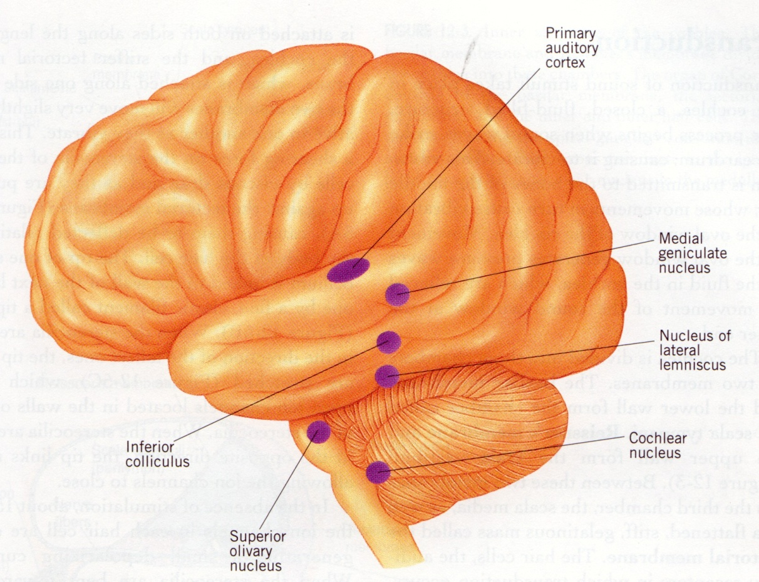
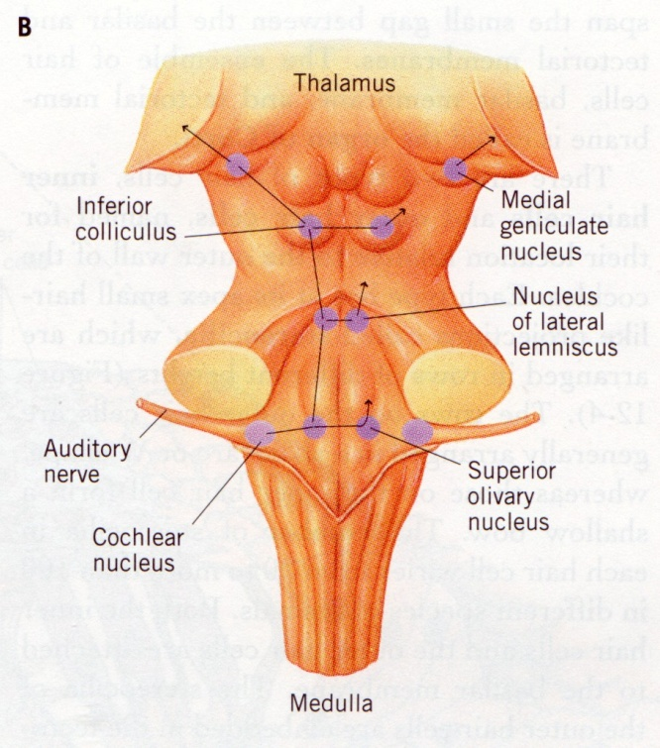
Auditory Pathway to Cortex

Slide 9
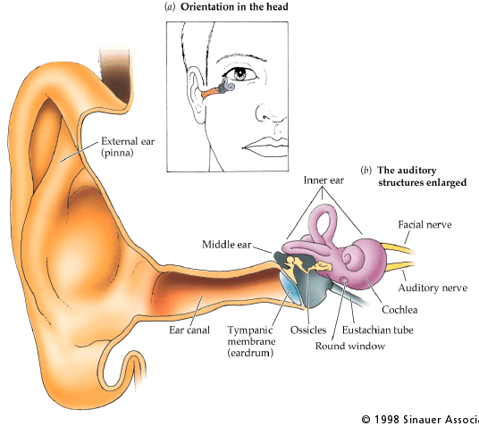
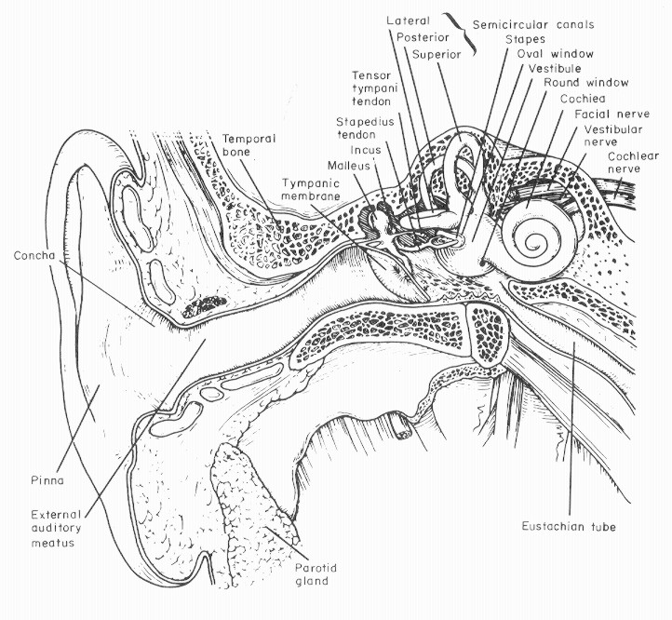
The Cochlea
Frequency analysis
Transduction into neural impulses

Slide 10
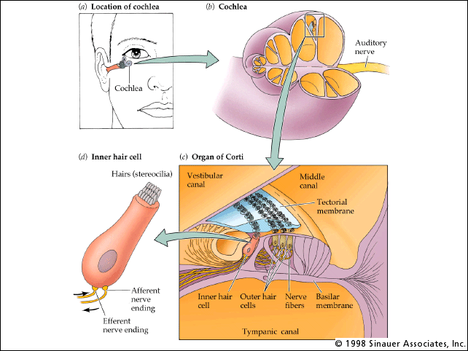

Slide 11
These Are Your Stereocilia
These Are Your Stereocilia On Loud Sounds

Slide 12
TURN IT DOWN!

Slide 14
Frequency-to-Place (Tonotopic) Map
Approximately logarithmic arrangement of frequency along basilar membrane
High frequencies near base
Low frequencies near apex
20,000 Hz
2,000 Hz
200 Hz
20 Hz
Base
Stiff and narrow
Apex
Wide and floppy

Slide 15
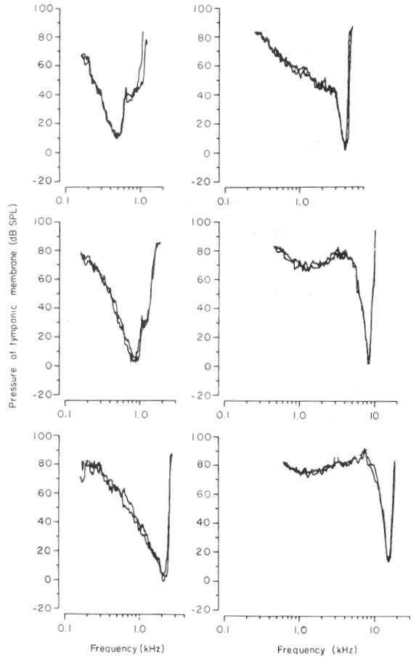
Tuning
Frequency response is usually plotted as a tuning curve – at how loud does a tone at a specific frequency have to be to excite an auditory nerve fiber
Auditory nerve fibers are narrowly tuned at high frequencies and broadly tuned at low frequencies
Tonotopic map in cochlea – high frequenies at base and frequency decreases as go to apex
Place theory of pitch perception

Slide 16
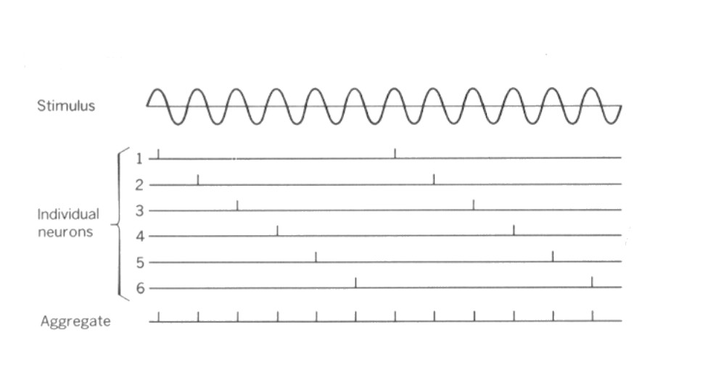
Volley Theory of Pitch Perception
The number of action potentials every second along with the time interval between action potentials determines the frequency (pitch) of the sound we are listening to.

Slide 17
Virtual Pitch
Pitch of the missing fundamental
1400 1400 1400 1400
1200 1200 1200 1200
1000 1000 1000 1000
800 800 800 800
600 600 600
400 400
200

Slide 18
Pitch of a Complex Sound
1 msec
1 msec
1 msec
1 msec
1 msec
1000 Hz
1200 Hz
1400 Hz
1600 Hz
1800 Hz
2000 Hz
200 Hz
0.83 msec
0.625msec
0.5 msec
5 msec

Slide 19
Pitch vs Timbre
Pitch
Timbre

Slide 20
Circular Pitch
Increase frequency and return to the same pitch
1400 1400 1400 1400
1200 1200 1200 1200
1000 1000 1000 1000
800 800 800 800
600 600 600
400 400
200

Slide 21
Circular Pitch
This demonstration uses a cyclic set of complex tones, each composed of 10 partials separated by octave intervals. The frequencies of the partials are shifted upward in steps corresponding to a musical semitone (~6%).
“Two examples of scales that illustrate circularity in pitch judgements are presented. The first is a discrete scale of Roger N. Sheppard, the second a continuous scale of Jean Claude Risset”.

Slide 22
Hair cells and auditory nerve fibers
The thresholds of auditory nerve fibers vary regularly with low threshold fibers on the pillar side of the inner hair cell and high threshold fibers on the modiolar side.
The low threshold fibers have high spontaneous activity rates, while the high threshold fibers have low spontaneous activity rates.
High spontaneous + low threshold
Low Spontaneous + high threshold

Slide 23
Inferences about auditory nerve fibers
Tuning: an auditory nerve fiber responds to a limited frequency range with fibers from the base tuned to high frequencies and fibers from the apex tuned to low frequencies (place theory of pitch perception).
Timing: auditory nerve fibers preserve temporal information at low frequencies (<4000 Hz) for pitch perception (volley theory) and for sound localization.
Threshold: auditory nerve fibers have different thresholds so that we can hear over a large intensity range while preserving timing information

Slide 24
Auditory Pathway to Cortex

Slide 25
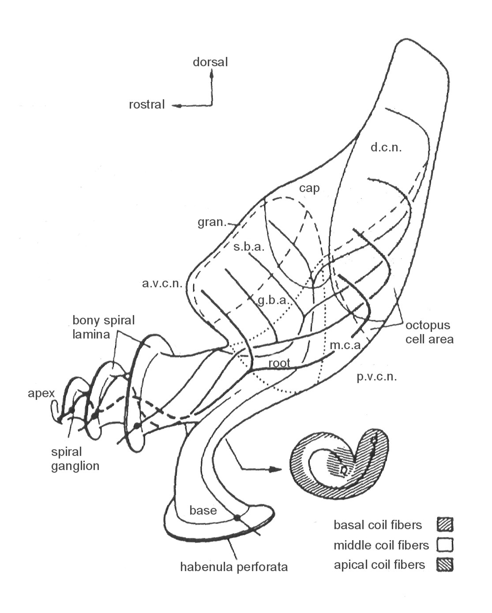
Parts of the cochlear nucleus
The cochlear nucleus is divided into dorsal (DCN) and ventral (VCN) parts
The ventral cochlear nucleus is divided by the auditory nerve into anterior (AVCN) and posterior (PVCN) divisions.
There is a tonotopic map in each subdivision.
high frequency
high
middle frequency
middle
low frequency
low

Slide 26
Neuron Signaling
Action Potential
Release small packet of neurotransmitter to cause excite or inhibit next neuron
Excitatory Postsynaptic Potential (EPSP)
Inhibitory Postsynaptic Potential (IPSP)
First must transduce physical signal
Action potential
EPSP
Na/K pumps active
Threshold
Resting potential (-60 to -70 mV)

Slide 27
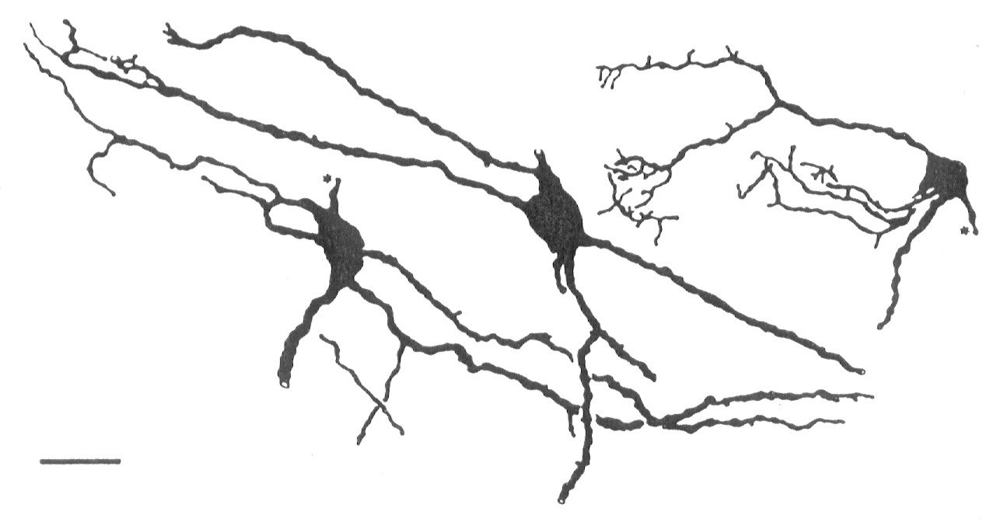
Stellate Cells
Stellate cells have dendrites that run parallel to the path of auditory nerve fibers
Each stellate cell receives many inputs from only a few nerve fibers
A stellate cell responds only to a narrow band of frequencies

Slide 28
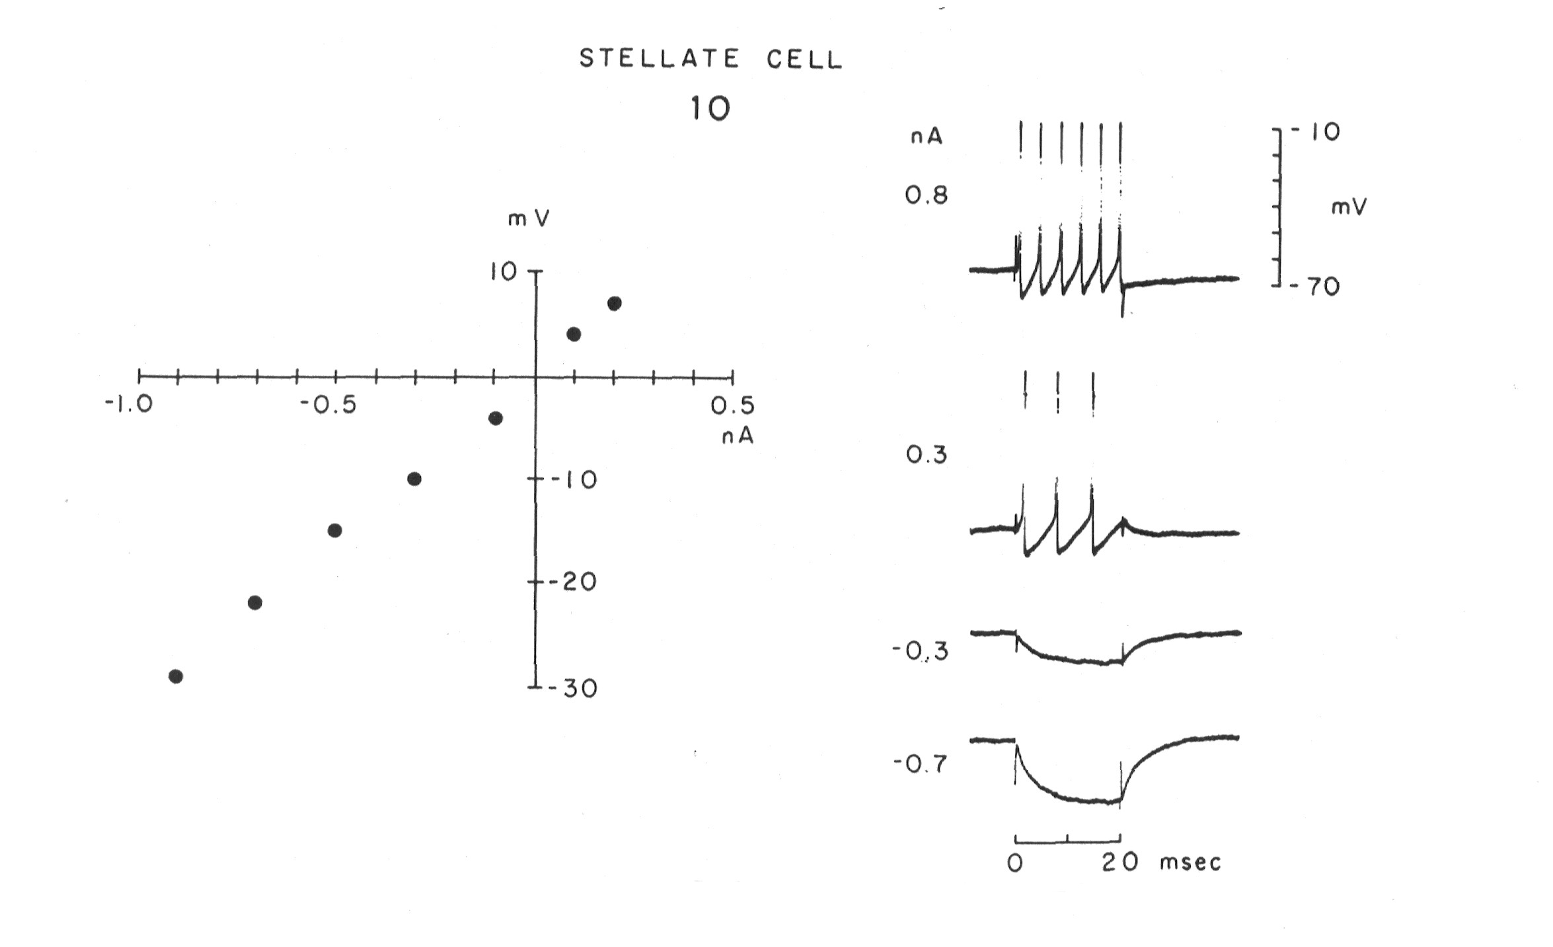
Stellate cells are linear
Stellate cells respond linearly to depolarizations and hyperpolarizations.
In response to depolarizing current, they produce a train of action potentials.

Slide 29
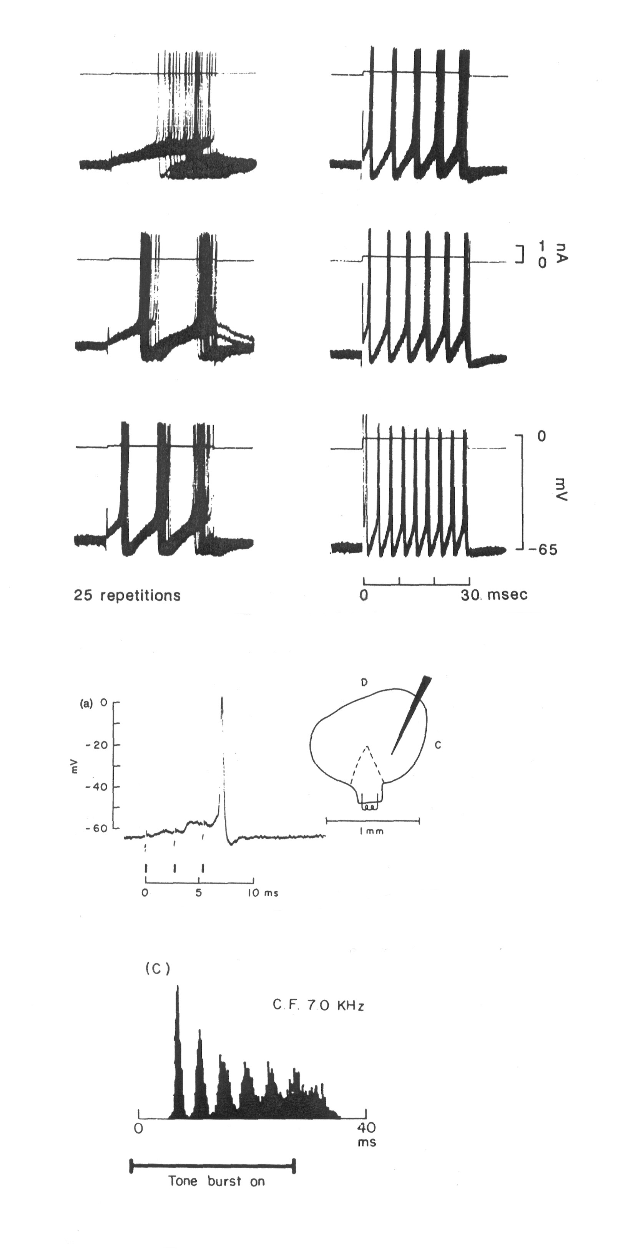
Stellate cells fire regularly in response to tones
The train of action potentials is very regular.
Stellate cells integrate information temporally (sum EPSPs) but not over a wide frequency range.
Stellate cells respond to tones with a “chopper” PST that reflects their regular firing pattern.

Slide 30
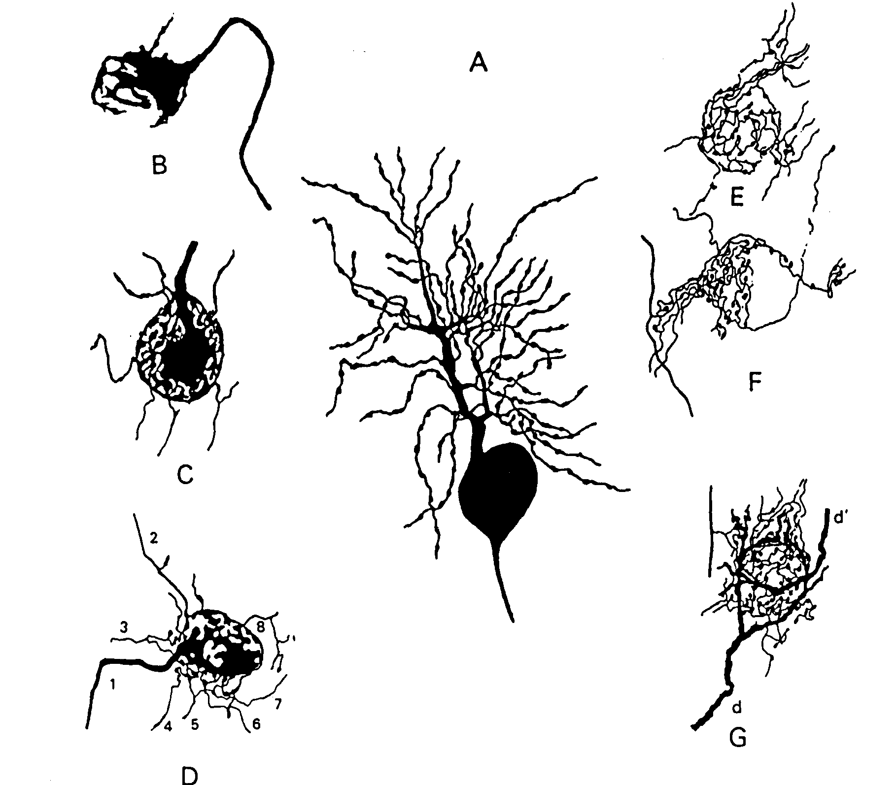
Bushy Cells
Spherical bushy cells (A) in anterior AVCN receive endbulbs of Held from only a couple of auditory nerve fibers (B,C,D).
Globular bushy cells in posterior AVCN receive multiple inputs from just a few auditory nerve fibers (E,F,G).
Each bushy cell responds only to a narrow band of frequencies

Slide 31
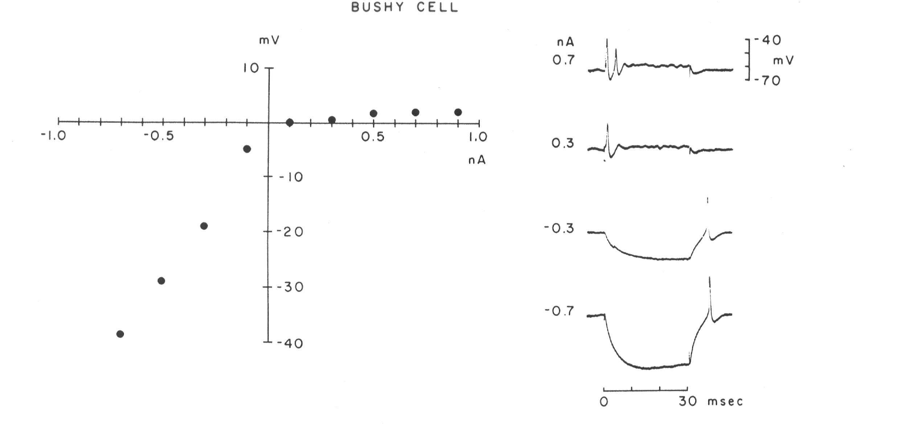
Bushy cells are nonlinear
Bushy cells are hard to depolarize. For long depolarizations they produce one or two action potentials.
Bushy cells are linear when hyperpolarized.

Slide 32
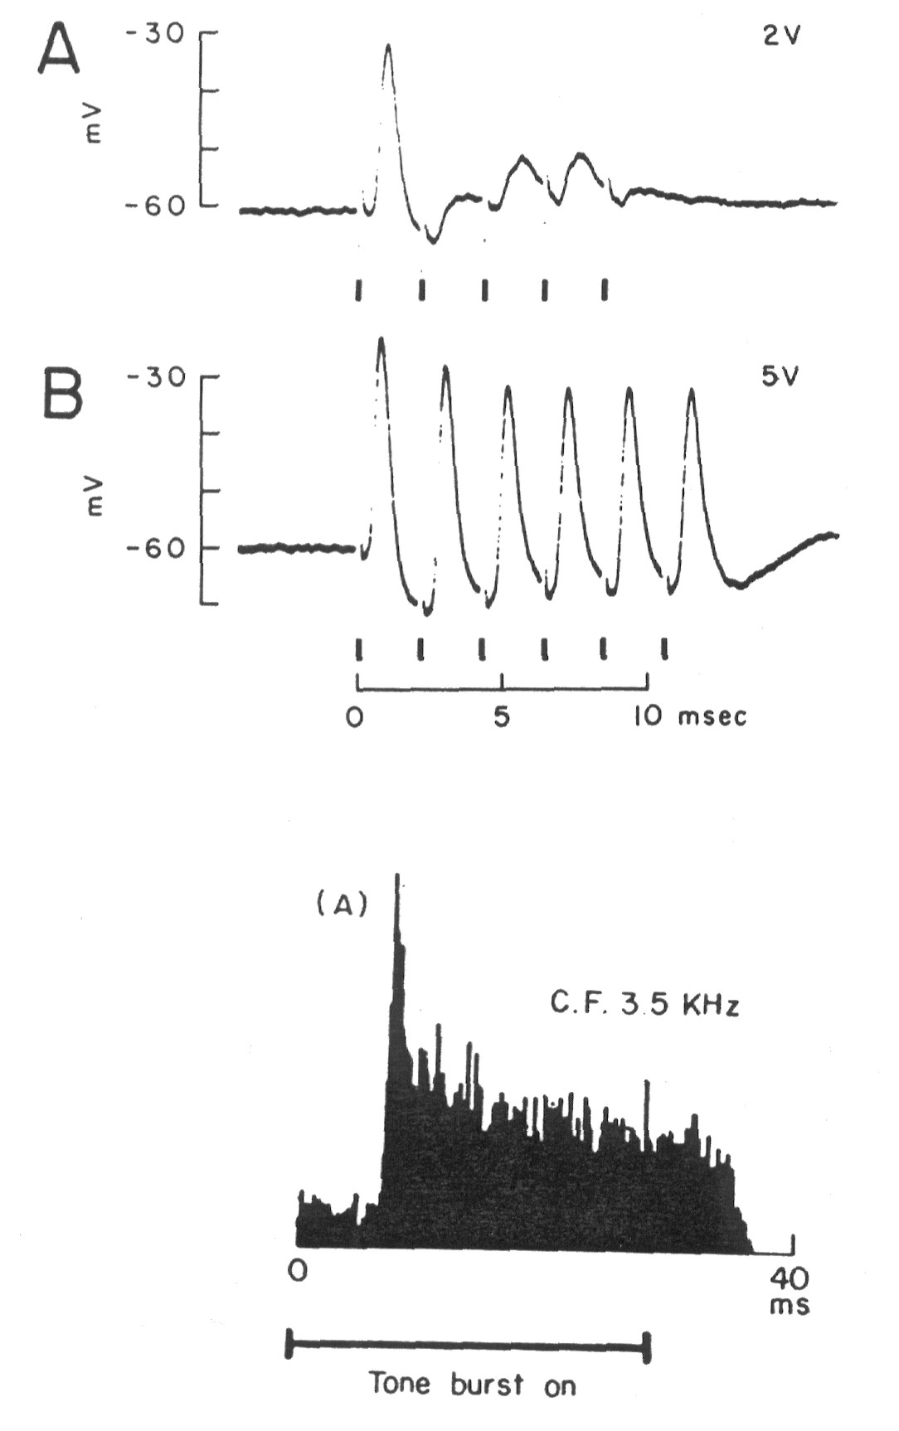
Bushy cells preserve temporal information
They do not integrate over time. Each auditory nerve input ( at | ) produces an EPSP, A&B, but there is no summation.
Bushy cells preserve the temporal characteristics of the auditory nerve input. Their peristimulus time (PST) histograms look like those of auditory nerve fibers, and are called Primary-like.
Temporal information needed for sound localization.

Slide 33
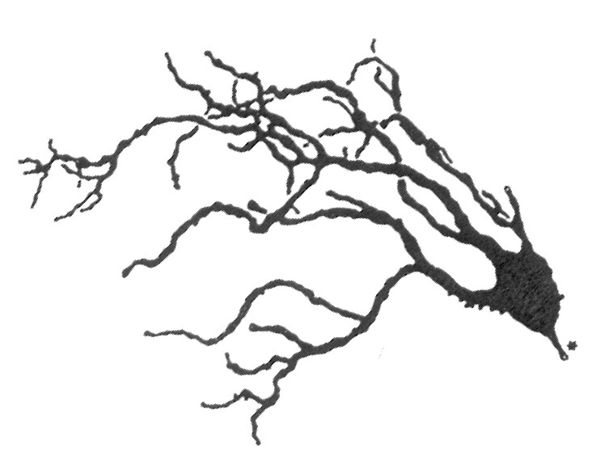
Octopus Cells in PVCN
Octopus cells have two or three large dendrites that extend perpendicularly across the paths of many auditory nerve fibers.
Octopus cells are ideally situated to integrate information across frequency.

Slide 34
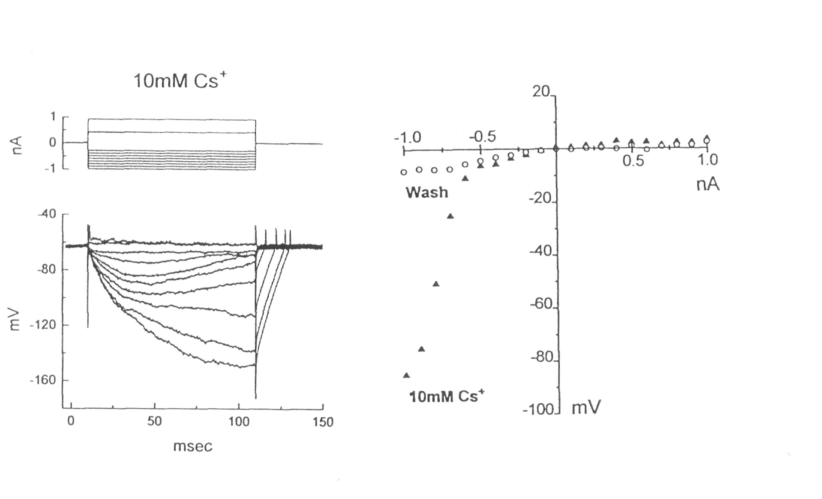
Octopus cells are nonlinear
Like bushy cells octopus cells are hard to depolarize and produce only a single action potential.
Octopus cells are also hard to hyperpolarize

Slide 35
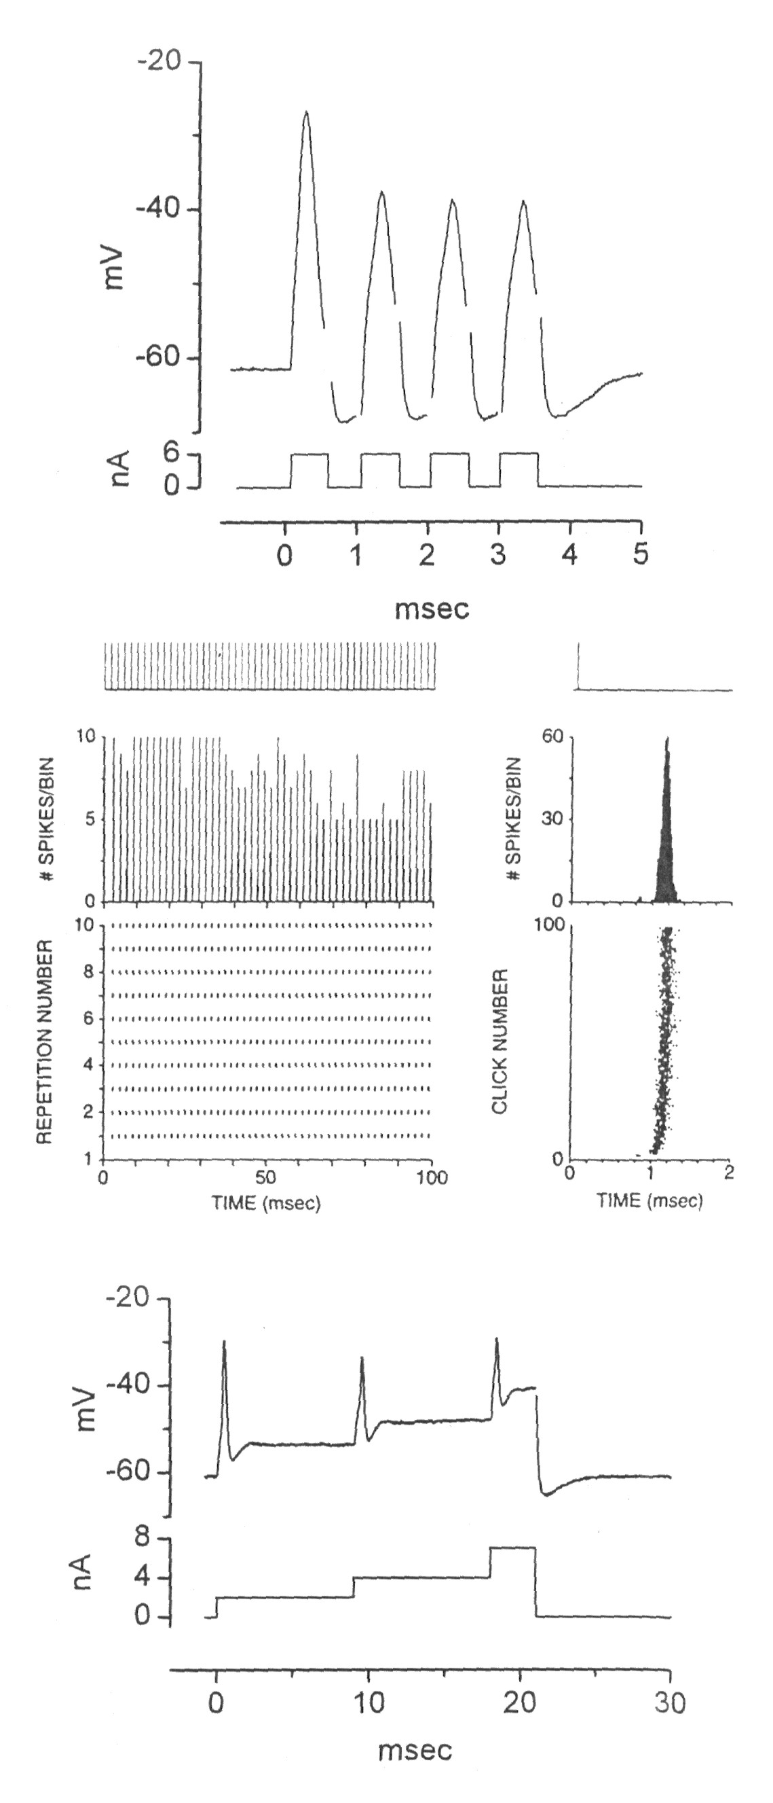
Octopus cells detect synchrony
Octopus cells respond to a tone with an “onset” PST histogram
Octopus cells are capable of firing very rapidly (1000 action potentials/second)
Octopus cells are activated by synchronous activity of many auditory nerve fibers generated by such stimuli as clicks.

Slide 36
Pitch of a Complex Sound
1 msec
1 msec
1 msec
1 msec
1 msec
1000 Hz
1200 Hz
1400 Hz
1600 Hz
1800 Hz
2000 Hz
200 Hz
0.83 msec
0.625msec
0.5 msec
5 msec

Slide 37
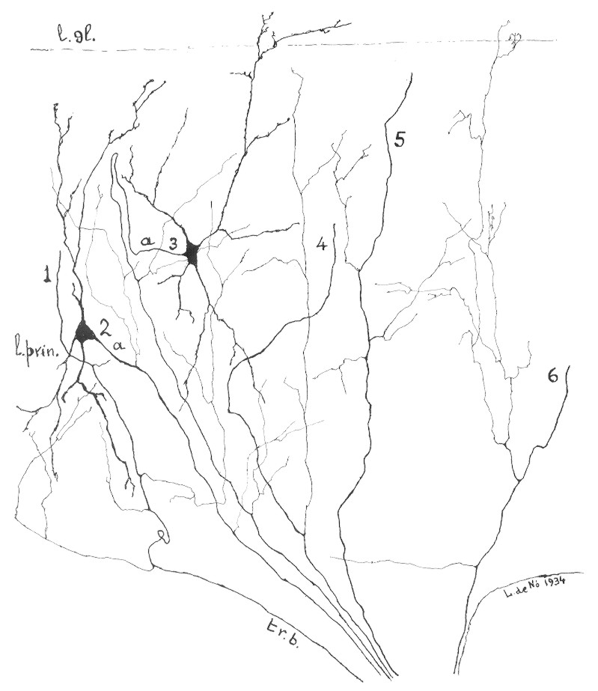
Multipolar Cells
Multipolar cells have dendrites that extend across a large number of auditory nerve fibers.
Multipolar cells project to the DCN, the AVCN and to the cochlear nucleus on the other side of the brainstem.

Slide 38
Characteristics of Ventral Cochlear Nucleus Neurons
 | Spherical Bushy cells | Globular Bushy cells | Stellate cells | Multipolar cells | Octopus cells
Tuning | Narrow | Narrow | Narrow | Broad | Broad
Intrinsic Membrane Properties | Nonlinear | Nonlinear | Linear | Linear | Nonlinear
PST Histogram | Primary-like | Primary-like with notch | Chopper | Onset - Chopper | Onset
Function | Preserve timing information | Preserve timing information | Loudness -integrate in critical band | Loudness – overall (AGC?) | Synchrony – integrate across freq.
Project to - send info | Superior Olivary Complex | Superior Olivary Complex * | Inferior Colliculus | Cochlear nucleus on other side | Lateral Lemniscus

Slide 39
Parts of the cochlear nucleus
The cochlear nucleus is divided into dorsal (DCN) and ventral (VCN) parts
The ventral cochlear nucleus is divided by the auditory nerve into anterior (AVCN) and posterior (PVCN) divisions.
There is a tonotopic map in each subdivision.
high frequency
high
middle frequency
middle
low frequency
low

Slide 40
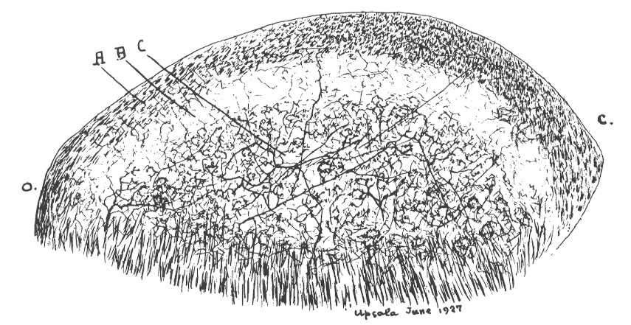
Dorsal Cochlear Nucleus
The dorsal cochlear nucleus is a layered structure.
Outer layer is the molecular layer and contains axons of granule cells
Large fusiform cell layer
Deep DCN – contains auditory nerve axons and neurons

Slide 41
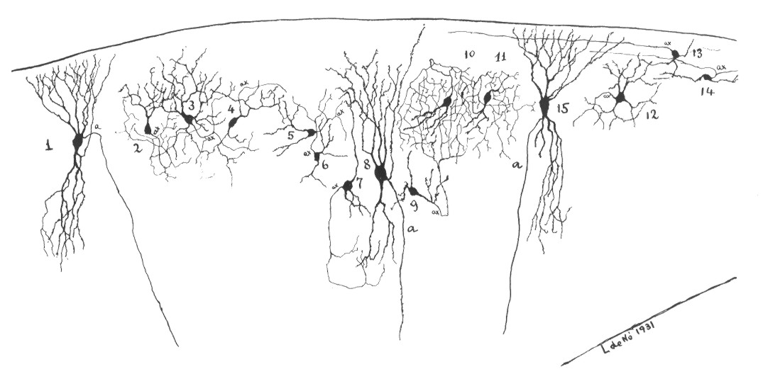
Molecular and Fusiform cell layers
Fusiform cells have two sets of dendrites – one set extends into the molecular layer perpendicular to the paths of granule cell axons, and the other set extends into the deep DCN to make contact with the axons of auditory nerve fibers.
Structure is similar to the cerebellum

Slide 42
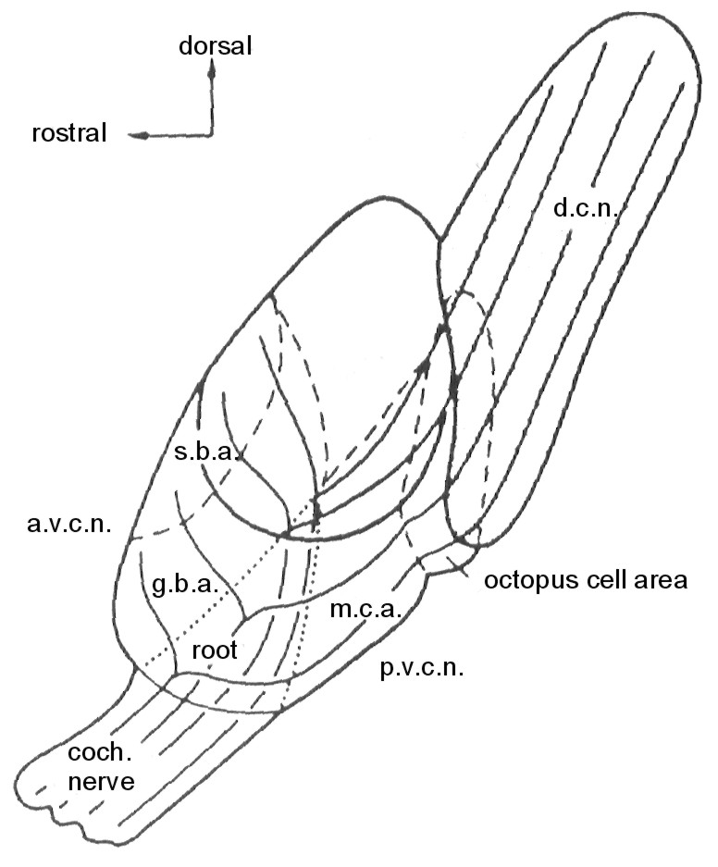
Role of cells in fusiform and molecular layers
Layers only found in animals that can move their ears
Humans lack these layers
Granule cells receive inputs from somatosensory nuclei in the brainstem
Perpendicular arrangement of granule cell axon and fusiform cell dendrites cross-correlates ear position with auditory input
cat
human

Slide 43
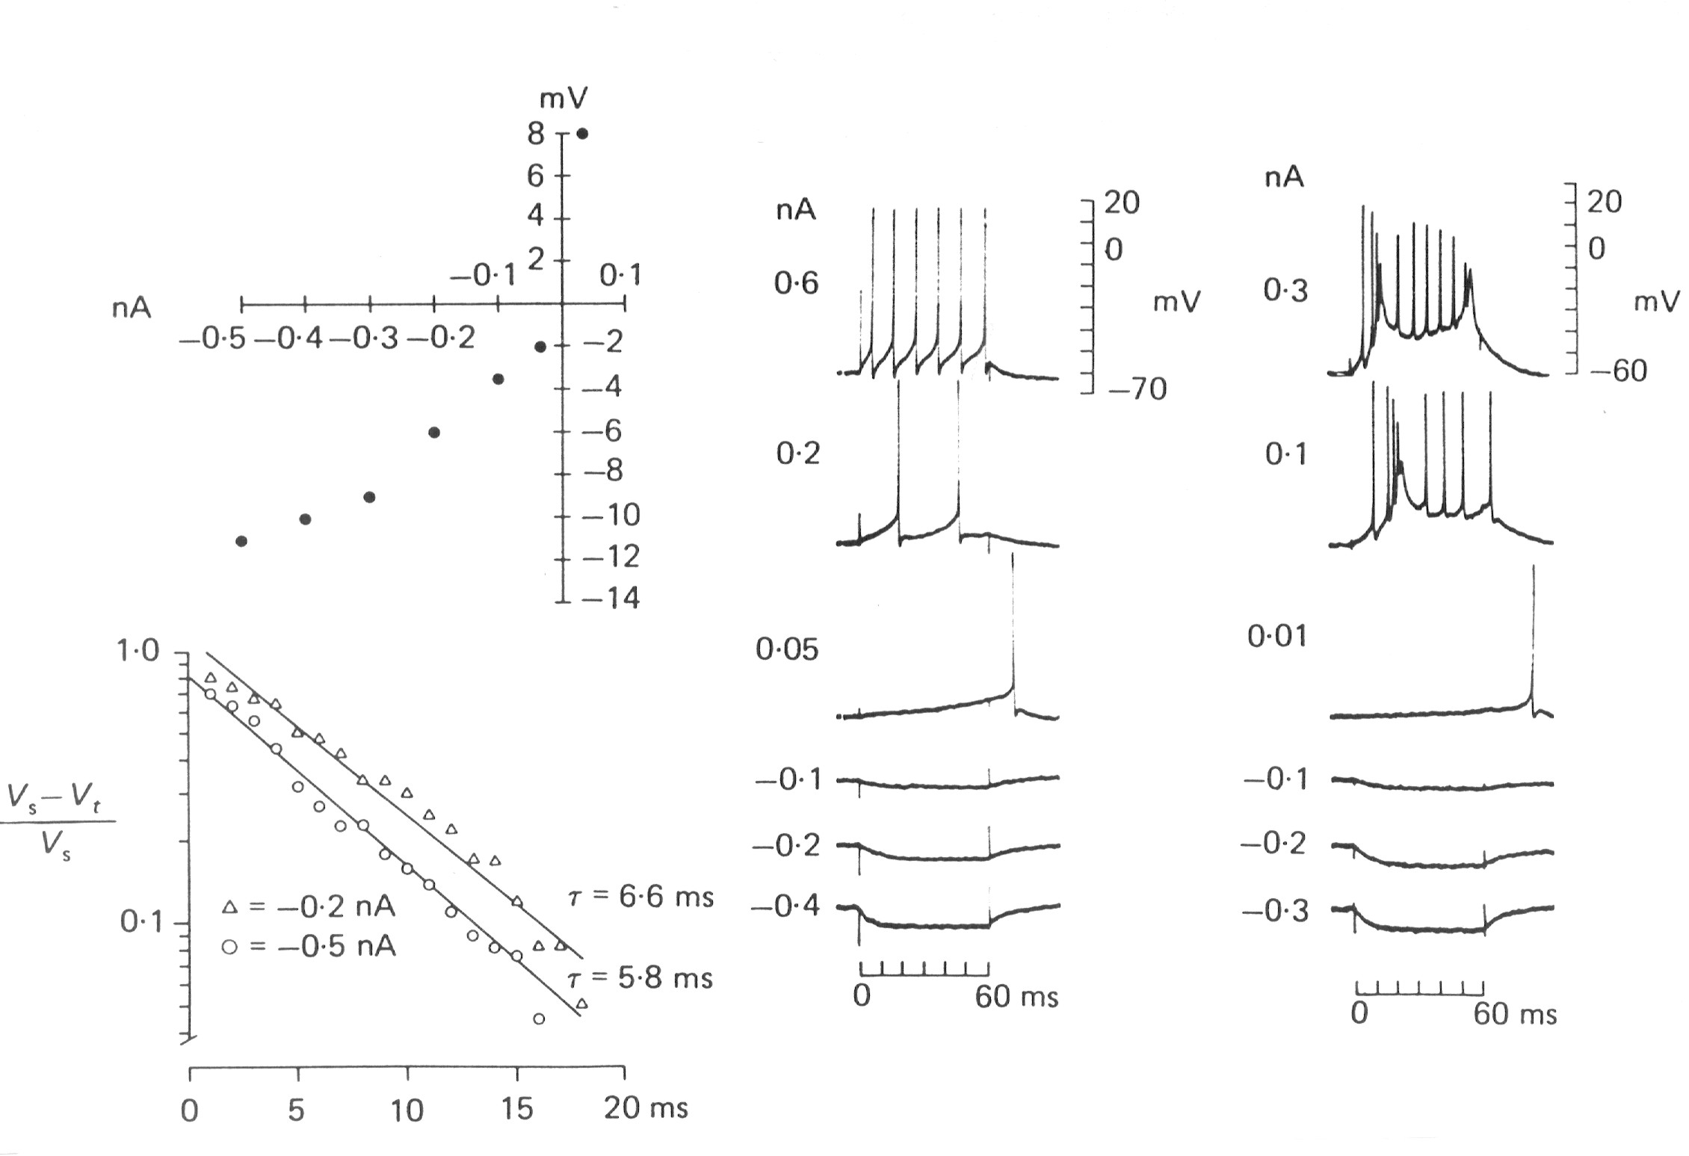
Fusiform cells are nonlinear
Fusiform cells have complex, nonlinear characteristics similar to Purkinje cell in the cerebellum

Slide 44
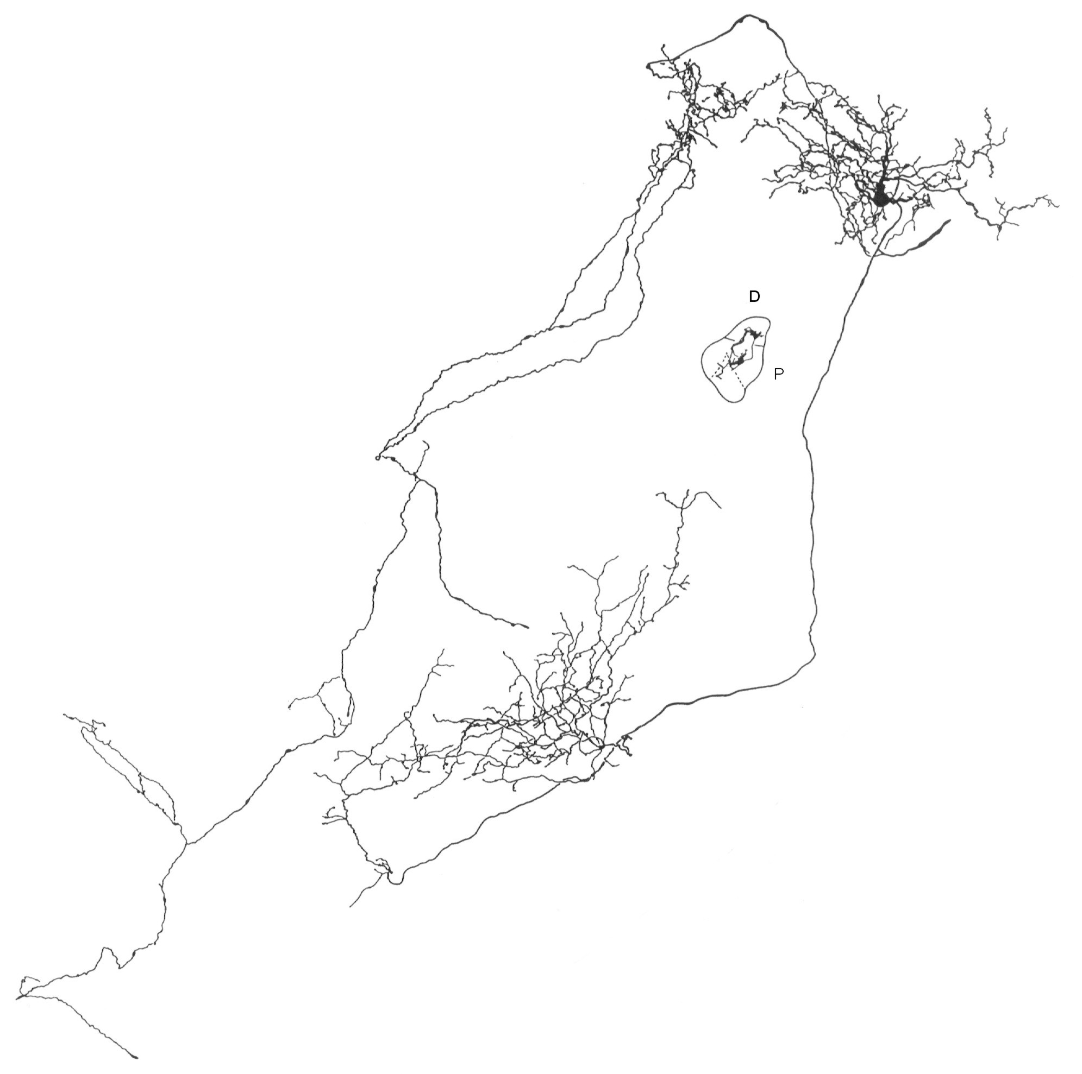
Tuberculoventral neurons
Tuberculoventral neurons in the deep layer of the DCN project to the VCN
They inhibit cells that receive inputs from the same auditory nerve fibers that innervate them – it is a frequency-specific inhibition
The inhibition is delayed
A delayed, frequency-specific inhibition can suppress echoes

Slide 45
Characteristics of Dorsal Cochlear Nucleus Neurons
 | Fusiform cells | Granule cells | Tuberculoventral neurons
Tuning | Narrow/broad sidebands | ? | Narrow
Intrinsic Membrane Properties | Nonlinear | ? | Nonlinear
PST Histogram | Pauser - Buildup |  | Many different shapes
Function | Compensate for motion of pinna | Convey info about position of pinna | Suppress echoes
Project to - send info | Inferior Colliculus | Molecular layer of DCN | Ventral cochlear nucleus

Slide 46
Role of the cochlear nucleus
Spread information from an auditory nerve fiber onto multiple parallel ascending pathways
Extract specific features of the stimulus
Intensity in a critical band
Overall intensity
Synchrony across frequency
Process information to make subsequent analysis possible
Echo suppression
Compensate for position of external ear (if necessary)

Slide 47
Auditory Pathway to Cortex

Slide 48
Projections from the cochlear nucleus
Superior Olivary Complex
Bushy cells
Tonotopic
Medial Geniculate Nucleus in Thalamus
Cochlear Nucleus
Stellate cells
Fusiform cells
Inferior Colliculus
Nuclei of the Lateral Lemniscus
Octopus cells
Non-tonotopic

Slide 49
Sound Localization in Superior Olive
Location of a sound must be computed by auditory system
Two cues
Difference in the arrival time of the sound at each ear
Intensity difference between the two ears caused by the head
Medial superior olive computes time difference
Lateral superior olive computes intensity difference

Slide 50
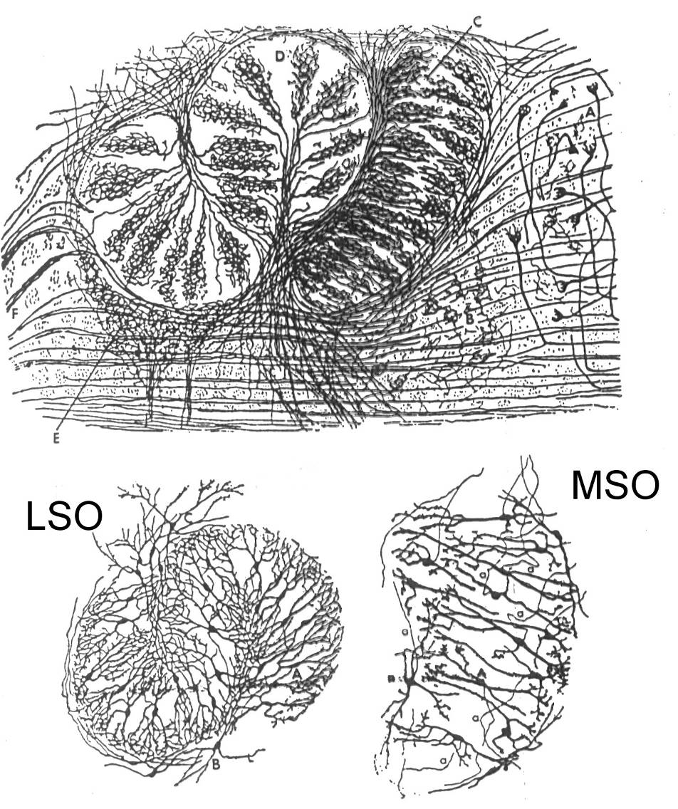
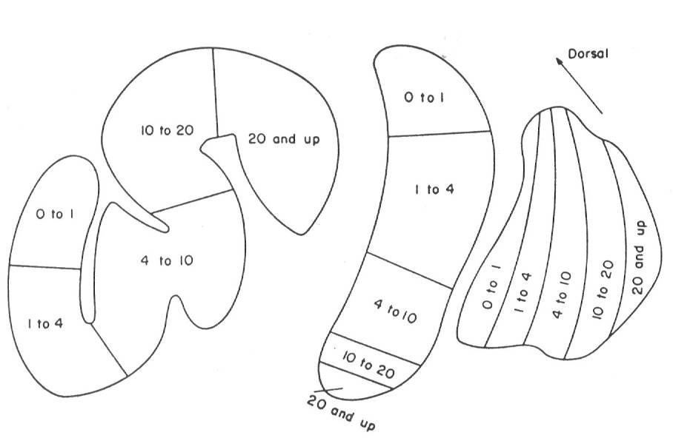
Structure of the LSO and MSO
LSO neurons respond to intensity differences between the ears
MSO neurons respond to the timing differences between the ears

Slide 51
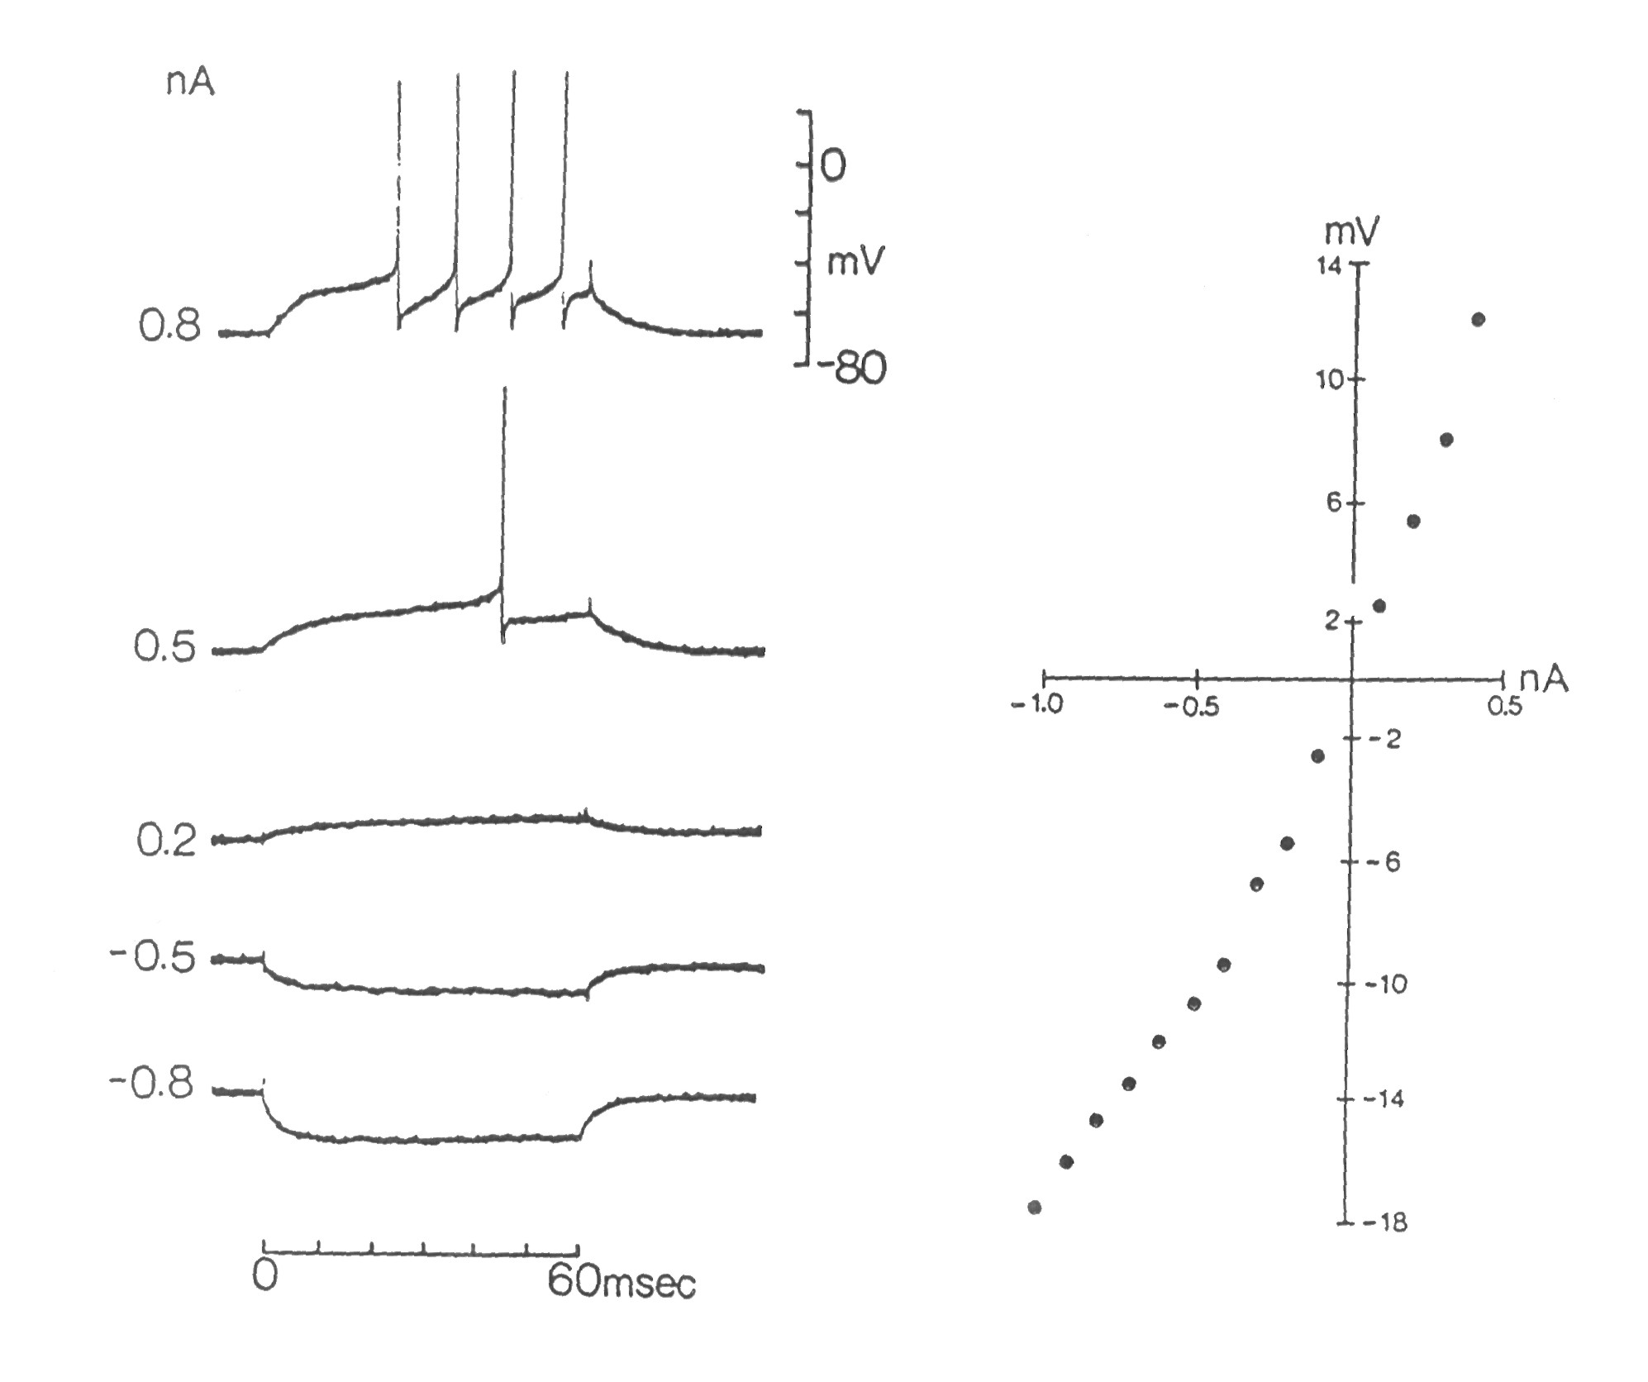
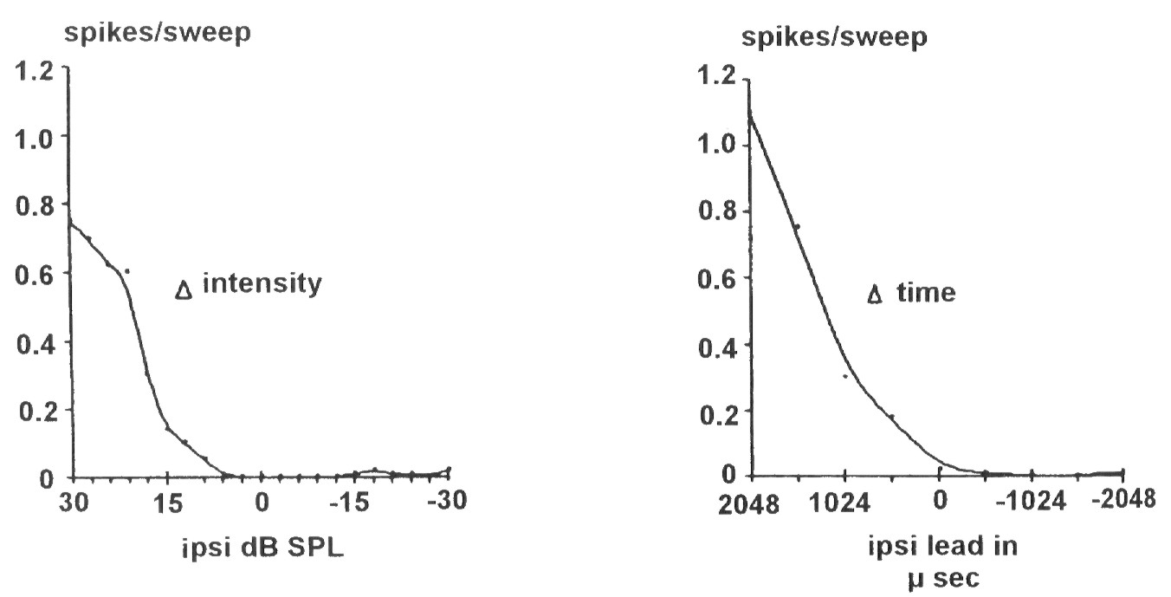
LSO processes intensity differences
LSO neurons respond mostly to high frequencies
Excited by sound at the ipsilateral ear (from spherical bushy cells)
Inhibited by sound at the contralateral ear (from globular bushy cells via MNTB)

Slide 52
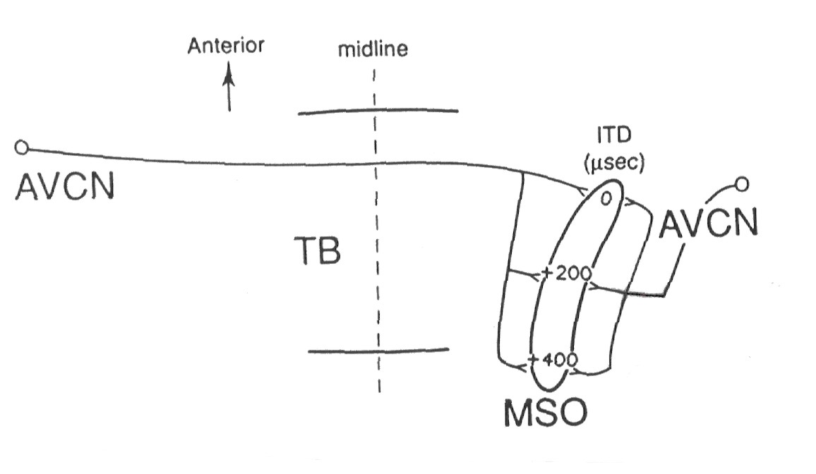
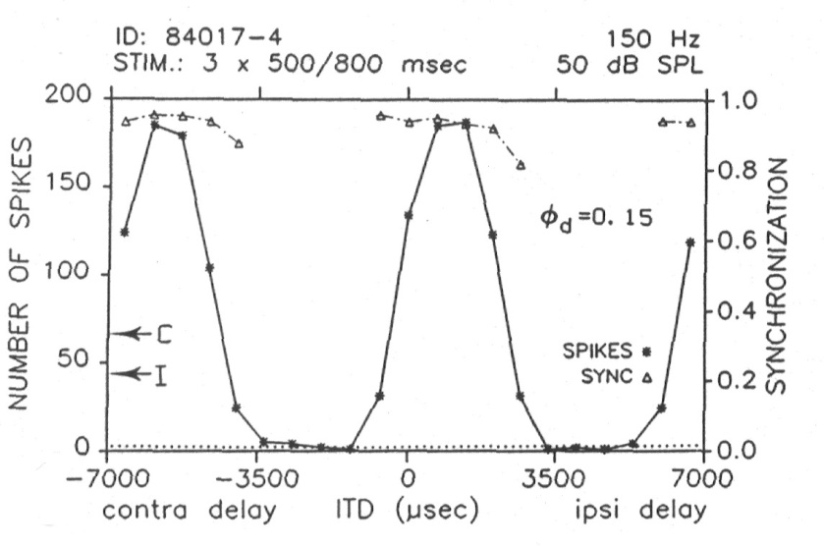
MSO processes timing differences
Delay lines
MSO responds mostly to low frequency sounds
Cells in the MSO are coincidence detectors
Input from the opposite side is delayed
MSO cells respond at specific interaural time difference (ITD)
Center to ear encoded from front to back in MSO

Slide 53
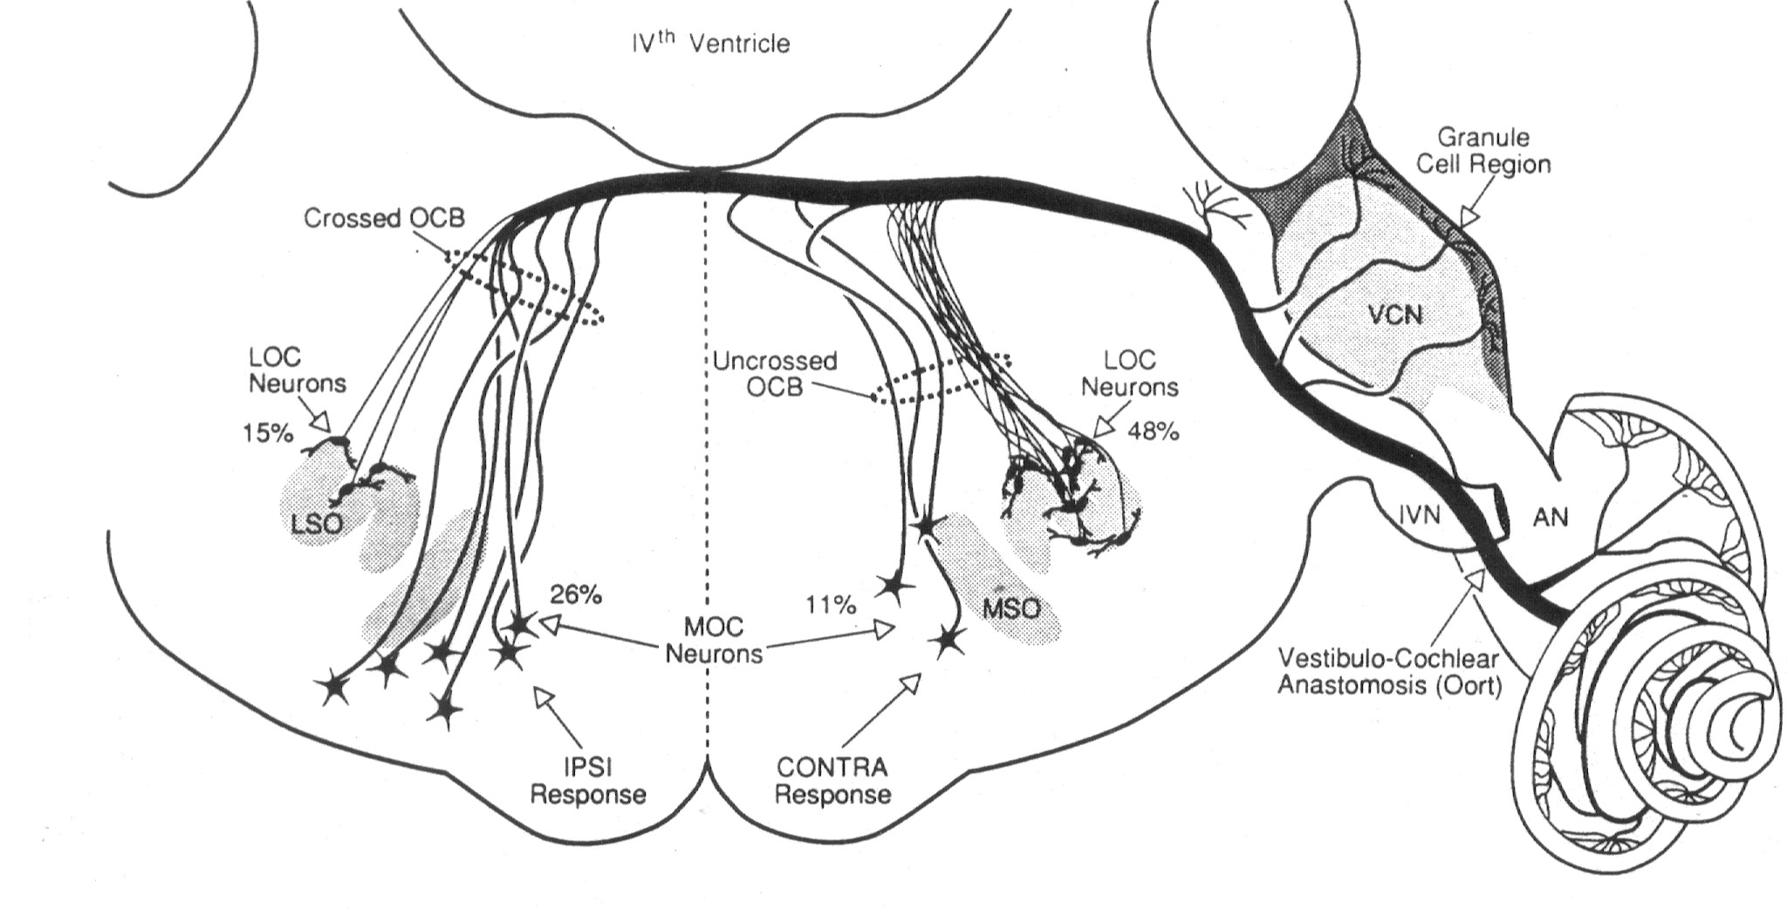
Descending pathway (efferents)
Two pathways project from the SOC to the cochlea
Medial system (around MSO) – large, myelinated fibers
Lateral system (around LSO) – thin, unmyelinated fibers

Slide 54
Auditory Areas in Neocortex
Primary auditory cortex is in the temporal lobe on the bank of the Sylvian fissure
Wernicke’s area involved in speech analysis (Broca’s area is for speech production).
All components of speech identified and combined before the information reaches this level.

Slide 56
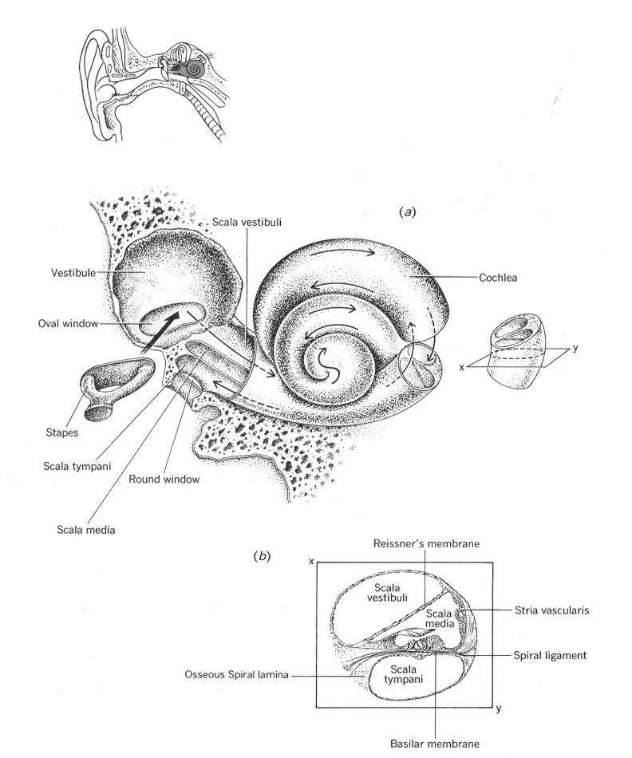
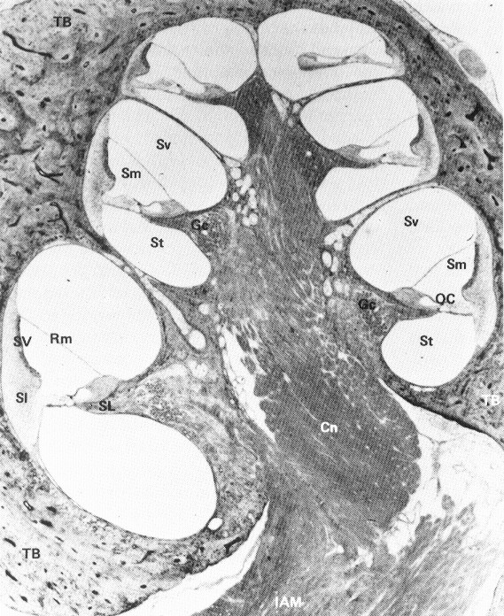

Slide 57
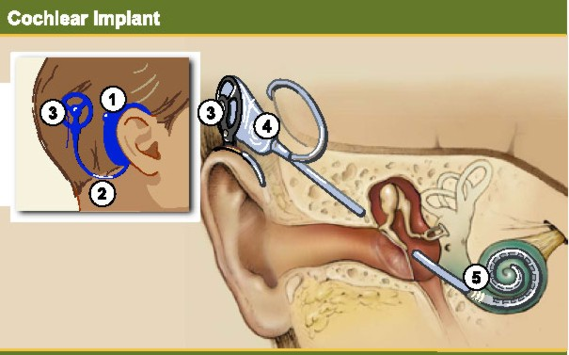
Exciting the Cochlea Without Sound
Auditory nerve fibers send message to brain following depolarization produced by neurotransmitter.
For deaf people, the nerve can be depolarized by stimulating with electrical current from a cochlear implant.

Slide 58
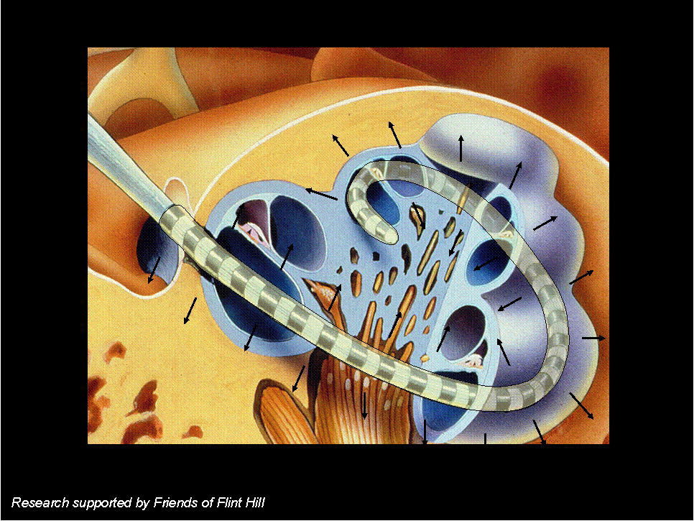
Implant Electrodes Stimulate Auditory Nerve

Slide 59
“Today” in Natural Speech
Natural & Noise Vocoder Speech Today

Slide 60
“Today” in Noise Vocoder Speech

Slide 61
1 to 4 bands of Noise Vocoder Speech

Slide 62
What Role for Frequency?
Speech can be recognized using 4 bands of noise
Can you recognize this sound generated with
4 bands?
8 bands?
16 bands?
32 bands?
original sound

